Slide 1
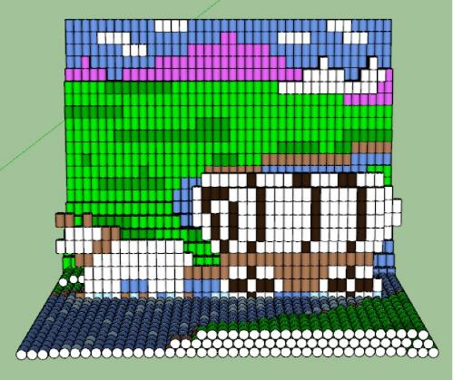
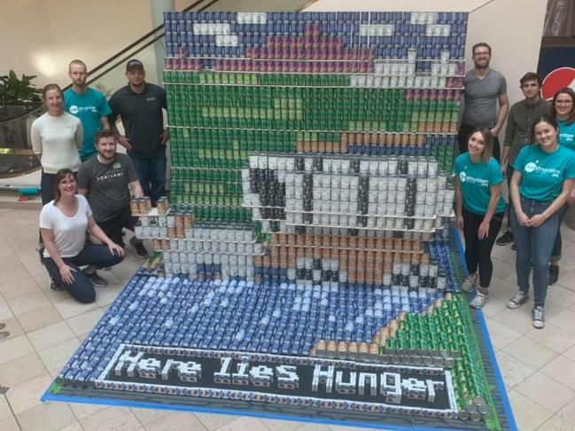
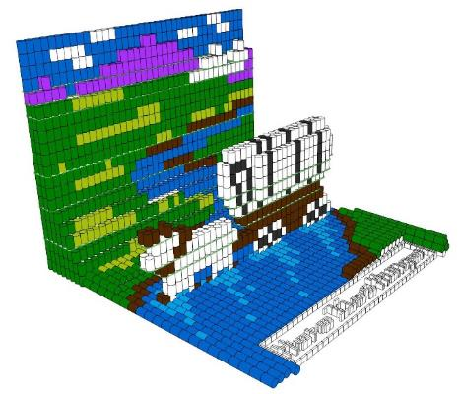
2021 Virtual CAN Opener
Notes:
*Angie, could you start the recording?* Welcome all you beautiful “Little Talking Boxes.” I am Christopher Mount, and this is our Virtual CAN-Opener. We are proud to be here to discuss our this years Canstruction Portland which will support Oregon Food Bank. No that I have your attention, could you please go to the chat and type in your first and last name, email, and firm for our signin list. Last year we were able to raise over $8,000 in our “Hindsight 2020!” and we hope to do better this year. Let’s continue this “CAN” call for teams, sponsors, and volunteers.

Slide 2
Meeting Outline
Virtual Canstruction?
Participation
Community Event
Sponsors
Volunteers
Design Team
Design Inspiration
Event Rules
Oregon Food Bank
Questions
Notes:
Tonight, we will go over this year’s event and how you can participate as a volunteer, team, or sponsor. At the end, Zakiya Jackson from Oregon Food Bank will talk about their work in our community.

Slide 3
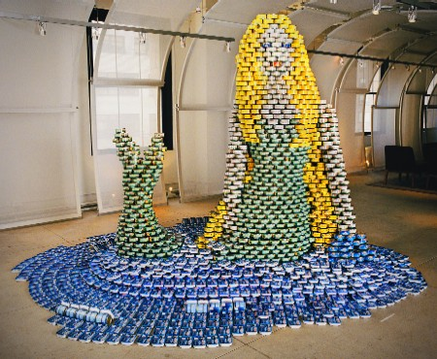
Virtual Canstruction?
A fun and unique design-build competition for architects, engineers, and construction professionals.
The 2021 Event will be a 3-D model design competition with fundraising but without the construction phase.
Also coloring contest, stack-at-home and social media (TikTok) competitions.
Notes:
This year’s main design event will be 100% virtual due to the uncertainties in the world and we just not ready to be that social. Can our community of contractors, engineers, and architects use their combined talents to build larger than life structures out of virtual food? We know you can, and together we will raise awareness of the hunger issue our community faces, virtually. Last year, we started a new aspect of our event where we invited the community to participate, and it was a success. This community aspect of the event will continue and we encourage you to tell your friends.

Slide 4
Why Participate?
Help fight hunger in the Portland metro area.
Networking and positive exposure.
Team Building with your office & others.
Fun!
Notes:
Why not? You get to help raise funds for Oregon Food Bank, be creative, and have loads of fun.

Slide 5
How can I Participate?
Donate and sponsor the event
Volunteer for the committee
Create a Design Team
Coloring contest - June
Stack-at-Home on Social Media - July
Notes:
Participation is available in multiple ways. We need sponsors for the event, volunteers for the committee, and design teams. We also need the community to participate in the Coloring Contest and Stack-at-Home social media contest. Whichever way is the most convenient way for you to participate, it all helps the Oregon Food Bank during this time of elevated need in our community.

Slide 6
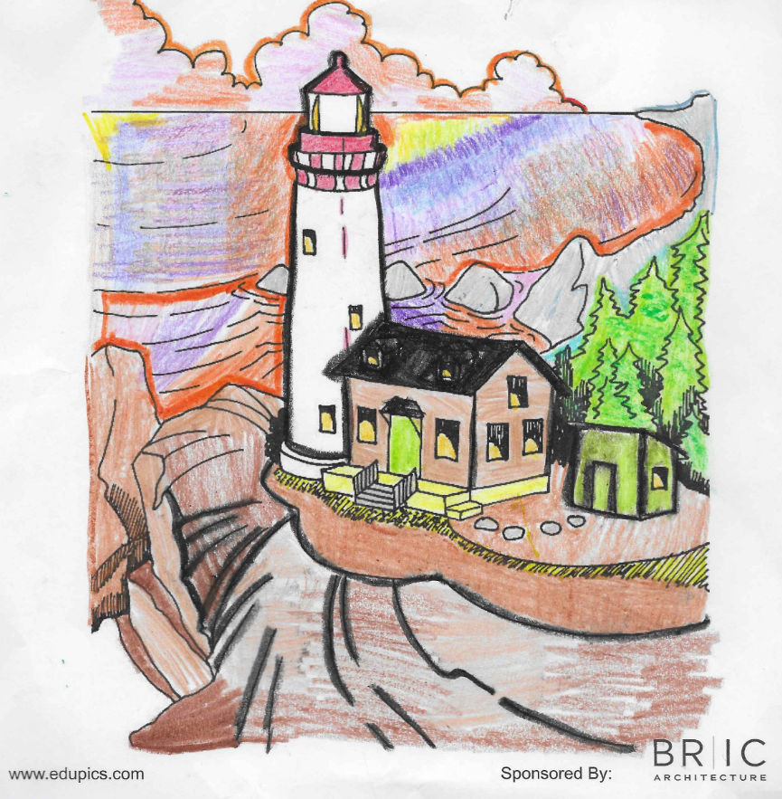
Show us the Community
Coloring Contest
Stacking at Home - Social Media Challenge
Fundraising
Notes:
For our community involvement part of the event, there is a coloring contest again this year with the images based on a Canstruction structure.
And there is Stack-at-Home with food in your pantry or go shopping for special color labels to create a unique design. See the Hulk face from last year?
Fundraising – you will have a chance to encourage your friends, family, co-workers, consultants, etc. to vote for your favorite designed structures thru the OFB website by donating directly to them.

Slide 7
Become a Sponsor
Help this event be possible
Menu of Giving available for cash donations
Email: sponsors@canstructionpdx.org
Notes:
One option is to be a sponsor which helps cover some of the expenses and services to make this event possible. Our expenses for the virtual mainly cover our website maintenance and the overhead costs. If you are interested in being a sponsor, please email us.
Currently, BRIC is committed at the Food Cart Lunch level.

Slide 8
Volunteering
Committee Members:
Marketing / Contacts
Community outreach
General help
Email: info@canstructionpdx.org
Notes:
Another option is volunteering to organize our event. There are several ways to help such as becoming part of the committee or just helping us out during the event (next year). You can see here some of the positions where we need help. If you are interested, please email us at info.

Slide 9
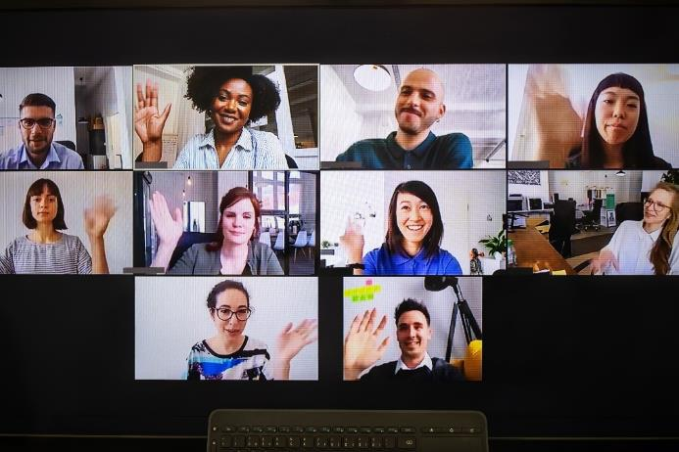
Create a Virtual Design Team
As one company:
All from one firm
Multiple offices
Team up with another company
Notes:
The final way to help on the corporate level is by forming a team. Show us your creativity and what you can do. We ask for all design teams be anchored by firm who is in the A/E/C community.

Slide 10
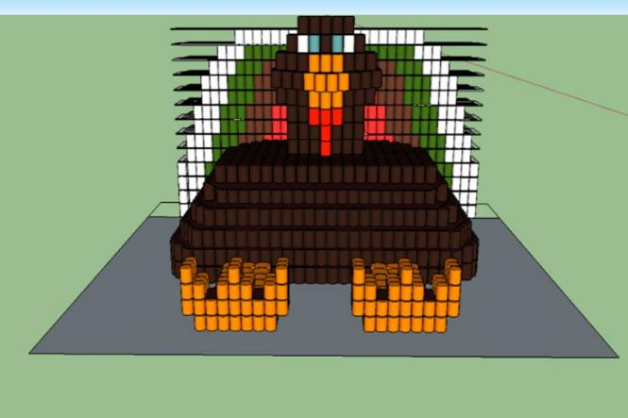
Be Inspired; Be a Voice
Illuminating the hunger issue?
Engaging all sectors of the public?
Showcasing an exciting design?
Creating a visual talking point?
Notes:
All structures are required to have a mission statement and this statement is up to you. We do not have a theme for our event. Most teams create the mission statement to fit their structures. Some teams find a structure to fit their mission statement. Both approaches work, but some brainstorming with your team will help you find a winning strategy.

Slide 11
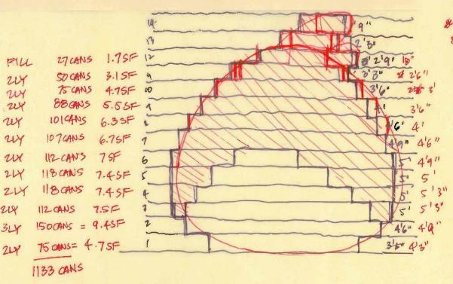
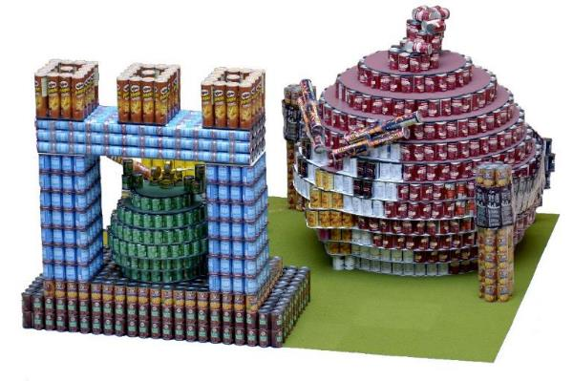
Make an Impact
Being a virtual event, we want your team to donate and fundraise through the OFB Canstruction fundraising site in support of your Canstructure design. Why not use money you would have normally raised to purchase your cans to support Oregon Food Bank during the event?
Food insecurity has doubled during the pandemic.
Angry Birds = 3,256 cans
Notes:
Once you have an idea, you can still work on your budget with the cans your have selected.
We are encouraging your team to fundraise or have your firm sponsor the amount that you would have spent on purchasing food and donate directly to OFB through our Canstruction Funding page in support of your structure.

Slide 12
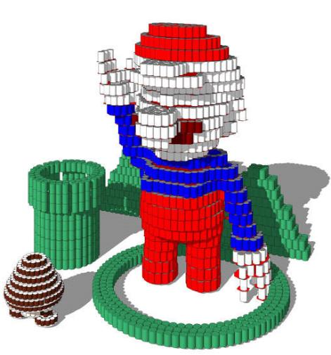
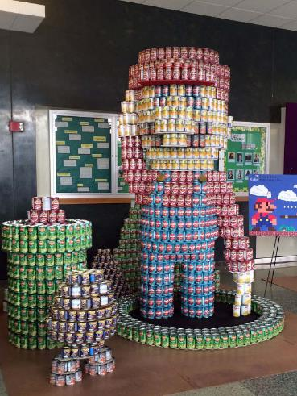
Virtual Event Tips & Ideas
Approach the design as if you were building out your structure.
“Shop” for your cans for food type and labels.
Scan can labels for use in your 3-D model to showcase colors and design.
Organize your “grocery list” of food and your can count for virtual submission as if full Canstruction event.
Notes:
Being virtual this year, we recommend you approach Canstruction the same way as if you were buying cans and building a structure. You will still need to “shop” for cans and colors and food type for your model. You can also scan your can labels to enhance your 3-D design for your model. You are required to provide a “grocery list” and can count for your virtual submission.

Slide 13
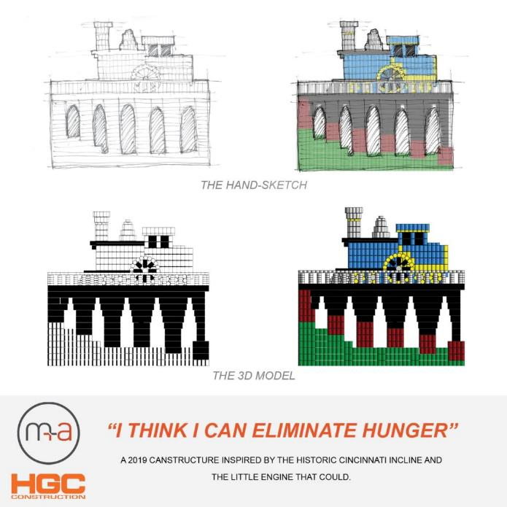
And the winner is…
Best Original Design
Best Meal
People’s Choice
Notes:
There will be 3 awards given this season.
Best Original Design: encompasses all the categories (top award).
Best Meal: food values, good sources of nutrition; can you create a meal from this structure?
People’s Choice: voting online on Facebook and other Social Media platforms. Recognizable (think pop culture).

Slide 14
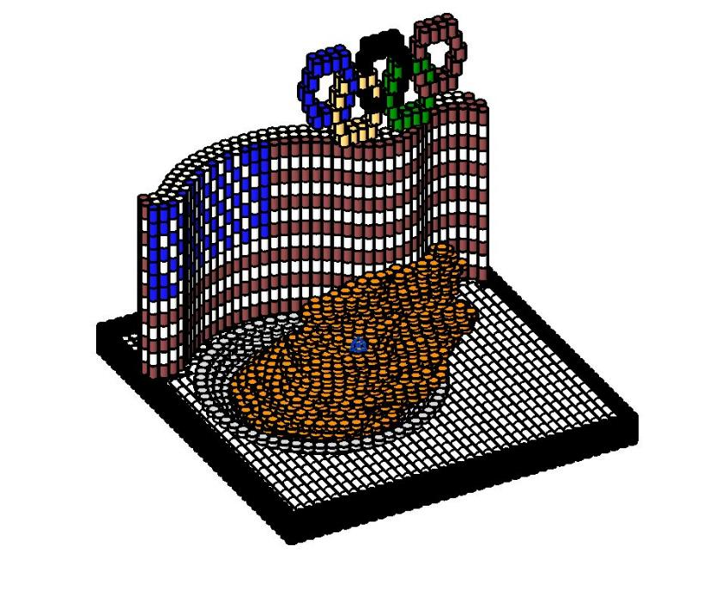
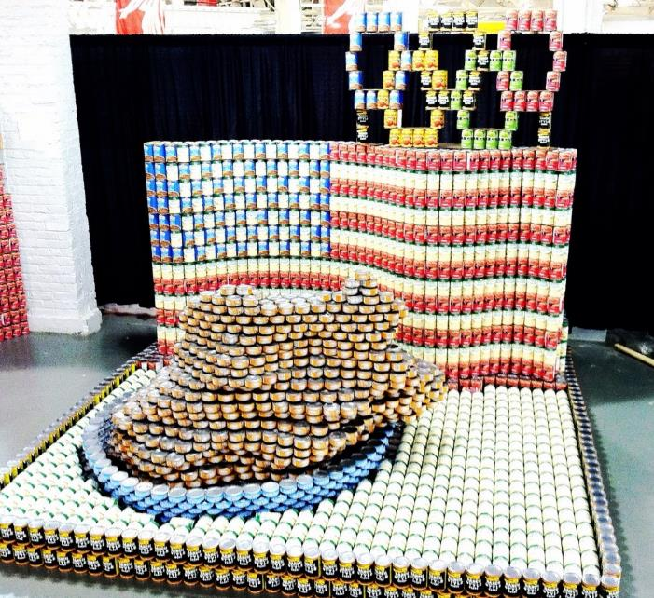
Event Rules
Notes:
Since we are having an event, there will be rules. Like I always say, “There are no power tools allowed in the mall!” Umm…that one might not be as helpful as usual.

Slide 15
Virtual Food
Non-Permissible Items:
NO glass containers or alcoholic beverages
NO junk food (e.g., candy, chips, etc.) or pet food
NO opened, exposed food/beverage
NO covered, removed or altered can/product labels
Notes:
Please do not include non-permissible items in your model.

Slide 16
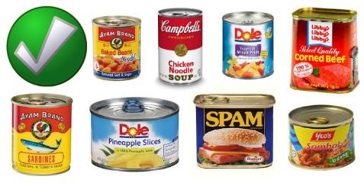
Virtual Food
Permissible Items:
Canned food of all sizes with labels intact/unaltered
Beverage cans of all sizes with labels intact (NO alcoholic beverages)
Plastic bottles/containers of food/beverage with labels intact/unaltered
Use of boxes, bags and packets of food is acceptable; however, cans must be used for the majority of the structure

Slide 17
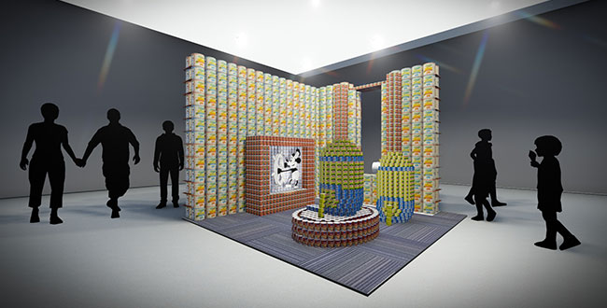
Virtual Design Regulations
Maximum size for structure is 10ft x 10ft x 8ft tall.
Use 3-D design software, such as Revit or Sketch-up.
Make your design buildable and see where your creative thoughts take you.
Notes:
We recommend scanning labels of the cans to make it more realistic. Your design must be buildable and work with real-world physics. Also, don’t forget to add the fake people and carpet to go the extra mile.

Slide 18
Submissions Schedule
Design Entry Deadline : Friday, June 11, 2021
Submittal No. 1: Friday, June 25, 2021 (structure idea)
Submittal No. 2: Friday, July 23, 2021 (title and mission statement)
Submittal No. 3: Friday, August 27, 2021 (final design, grocery list, can count team members, structure size)
Website has all submittal details: www.canstructionpdx.org
Notes:
Our first deadline is on June 11th to sign up for the event. We will have an entry fee of $50 dollars which you pay online at our website.
Additional deadlines are shown and will also be on our website including the submittal forms. We will also be providing information via our social media channels (Facebook, Twitter, Instagram, LinkedIn). Please like/follow us to stay informed!

Slide 19
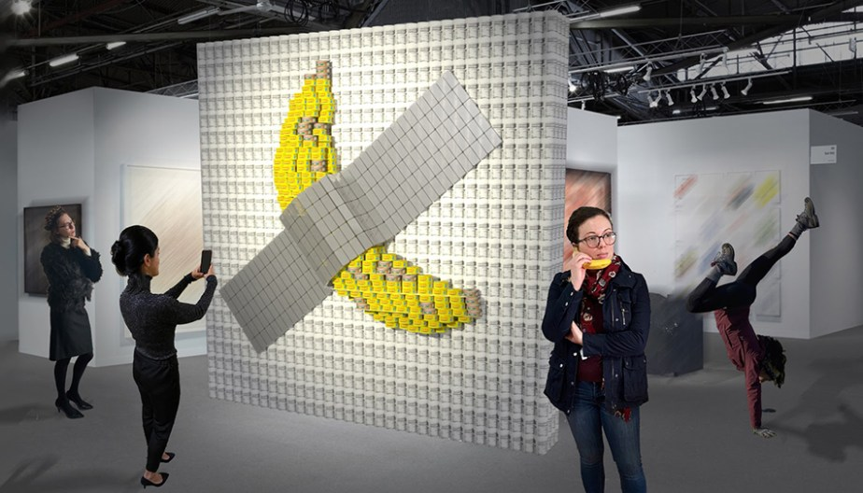
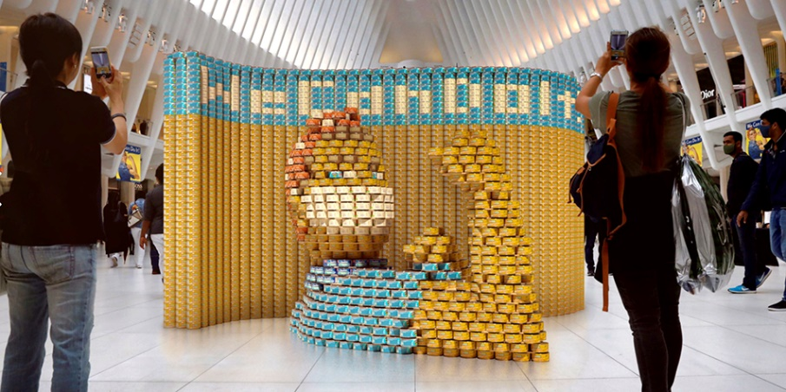
Virtual Event
September 1 - 30
Structures will be displayed online
Fundraising for each structure to raise money for OFB
Social Media will aid in getting community involvement with donations and likes.
Notes:
Our Virtual Event will showcase your structures online and use their message to fundraise for OFB. People will be able to see the structures via our website, OFB Fundraising Website, and social media. We challenge you and your team to get the word out and raise money through the OFB website.

Slide 20
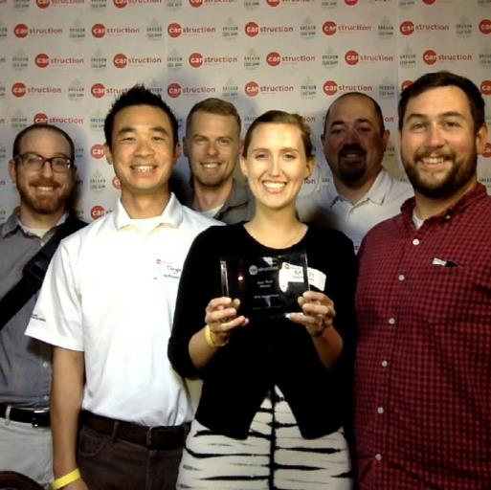
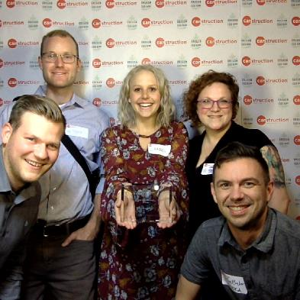
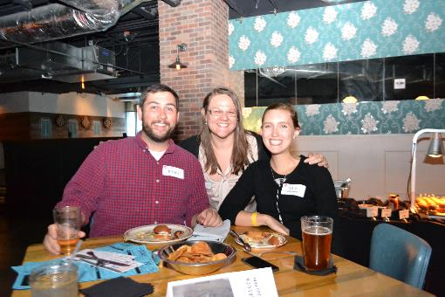
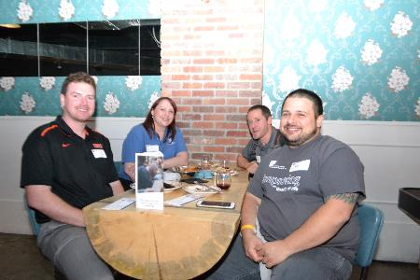
Virtual Gala
Celebrates our event and all your hard work.
Announcement of winners
Date to be announced (September)
Notes:
Join us by having a gala party with your team at your office and join us online.

Slide 21
Need Help?
Let us mentor your team:
Are you new?
Are you having a design issue?
Having a hard time with Mission Statement?
Are you stuck?
Contact:
Teams@canstructionPDX.org
Checkout the website:
Notes:
Sometimes this process can seem overwhelming, but we are here to help. Our committee has been at the event for over 23 years. We are available to mentor your team or to answer simple questions. Our website has base Sketchup models and Mission Statement examples.

Slide 22
Zakiya Jackson
Community Philanthropy Developer
zjackson@oregonfoodbank.org
Notes:
Hi all! I am Zakiya Jackson (she/her) and I am a Community Philanthropy Developer with the Corporate and Community Relations Team. Currently working remote by way of Madison, WI (Go Badgers) and have been with the Oregon Food Bank since February.

Slide 23
About Us
At Oregon Food Bank, we do things differently!
We started off like most food banks did back in 1988. That’s when Interagency Food Bank and Oregon Food Share merged to become the Oregon Food Bank we are today, and we distributed USDA Commodity Supplemental Food to over 200 hunger-relief agencies. Today, Oregon Food Bank collects food from farmers, manufacturers, wholesalers, retailers, individuals and government sources.
Notes:
Oregon Food Bank is an effective and efficient organization, with 92.4% of expenditures going to program support.

Slide 24
Locations
OFB is in Portland, Beaverton, Tillamook, The Dalles, and Ontario.
We integrate with 4 Oregon Food Bank branches and 21 regional food banks across Oregon and Clark County, Washington.
Notes:
21 regional food banks with 1,200 food assistance sites serving Oregon and Clark County, WA.
OFB is in Portland, Beaverton, Tillamook, The Dalles, and Ontario.
These 21 RFB’s come together as a formal network to collaborate, share resources and problem solve in order to most effectively and equitably serve our neighbors in need.

Slide 25
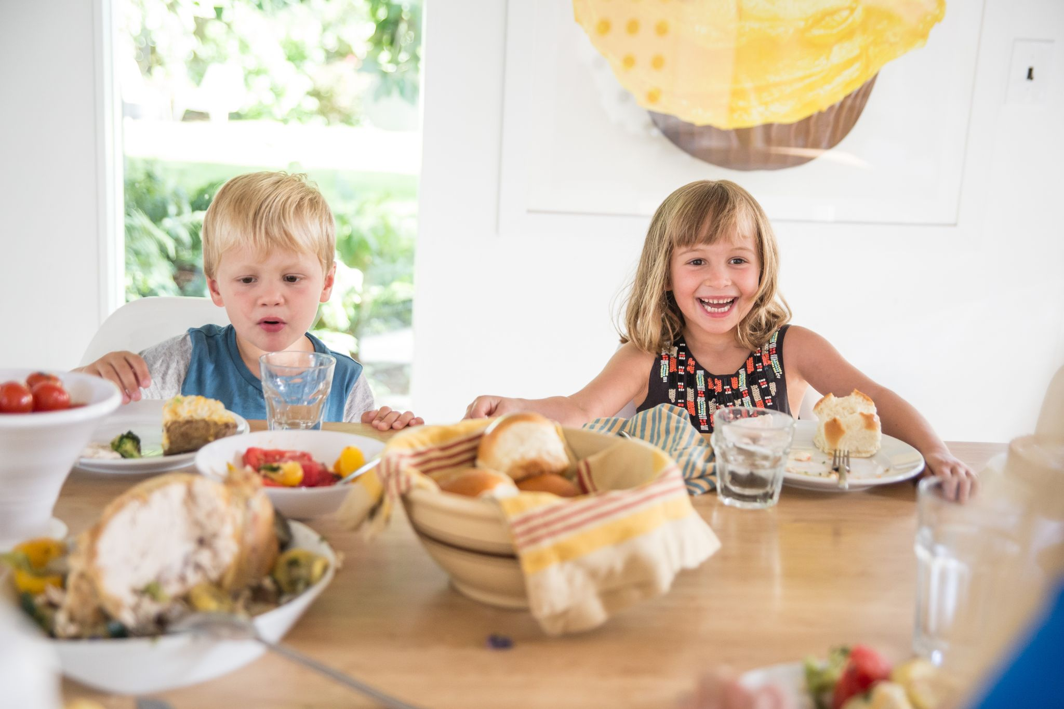
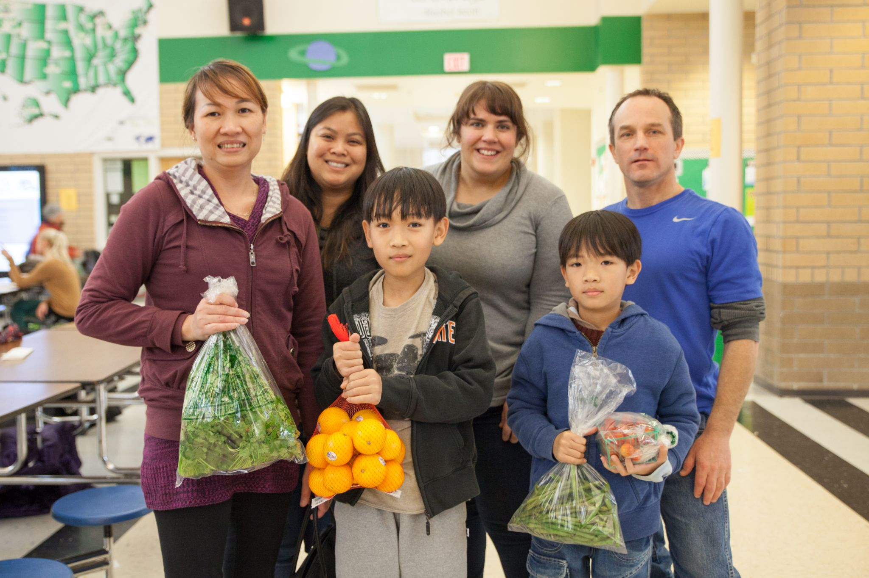
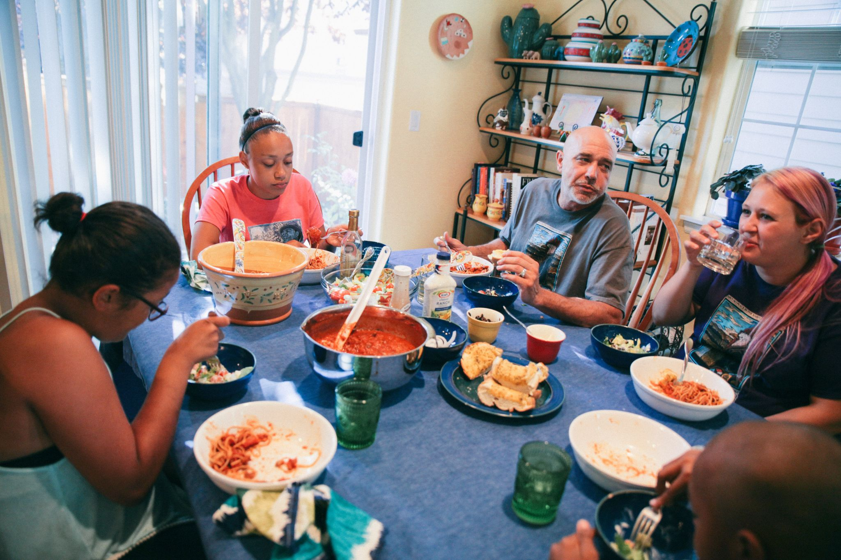
Hunger in Oregon
Oregon ranks 20th in the nation for food insecurity, and 16th for child food insecurity
A third of the people we serve are children
BIPOC, single mothers, caregivers, immigrants and refugees, LGBTQ individuals are disproportionately affected by hunger
Notes:
The COVID-19 pandemic has exacerbated inequities; Prior to the pandemic, 1 in 11 Oregonians were food insecure. Nearly 1 in 5 Oregonians faces food insecurity today — roughly double the levels we saw prior to the pandemic
The consequences of the pandemic, wildfires and economic recession have fallen hardest on people of color, immigrants and refugees, single parents and caregivers and trans and gender non-conforming people.

Slide 26
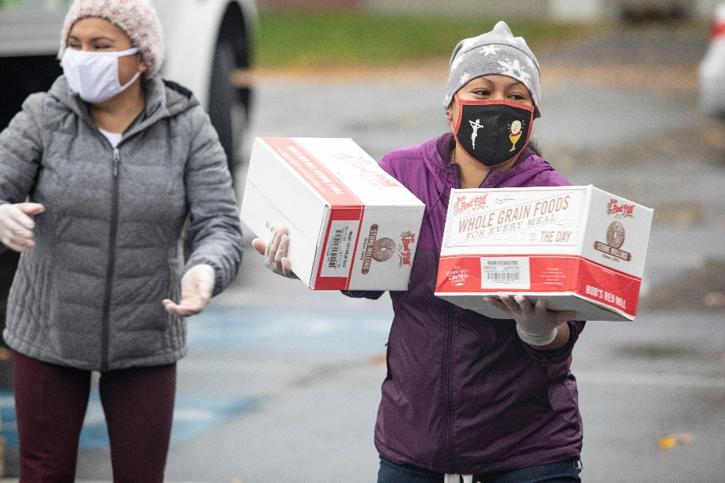
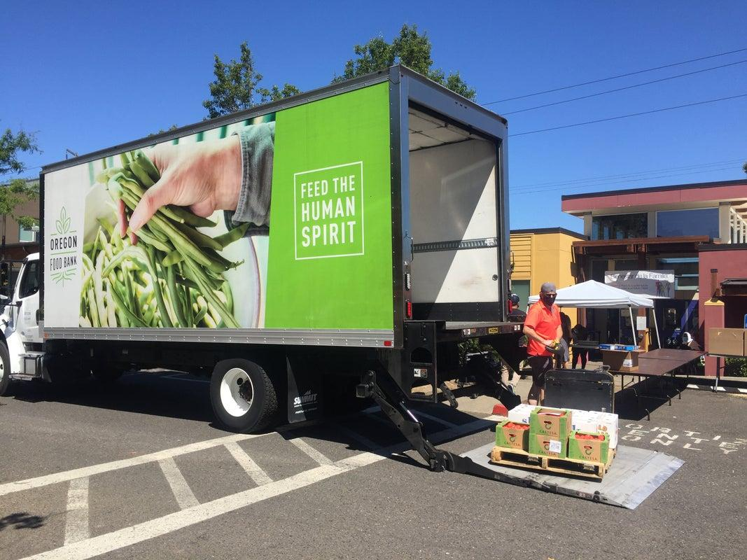
COVID Response
Hunger is at its highest level in almost a century – that means we are currently experiencing rates of hunger that equal those of the Great Depression in the 1930s.
Oregon State University estimates that the total number of Oregonians experiencing – or are likely to soon experience – food insecurity has doubled.
Notes:
or an additional 540,000-800,000 of our neighbors are turning to local food pantries, many for the first time.

Slide 27
Why are Oregonians Hungry?
Low and/or inconsistent wages, seasonal or irregular
45% of client households have at least one working adult
33% retired or unable to work due to disability/illness
17% unemployed
5% Staying at home to care for child, senior, or disabled person
With high cost of housing, people need to make difficult choices between rent or food
Medical bills or other life emergencies
Seasonal needs, such as summer child hunger when kids lose access to school meals.

Slide 28
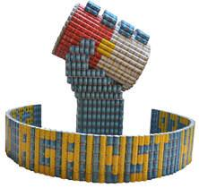
Equity at OFB
At Oregon Food Bank, we hold people experiencing hunger in Oregon and SW Washington at the center of our actions and decisions.
Notes:
We envision a community where each person can participate, prosper and have access to food that is both nourishing and in keeping with their culture. We recognize that systemic injustices exist – such as racism, classism, and sexism – and that these create and perpetuate conditions that sustain poverty and hunger.

Slide 29
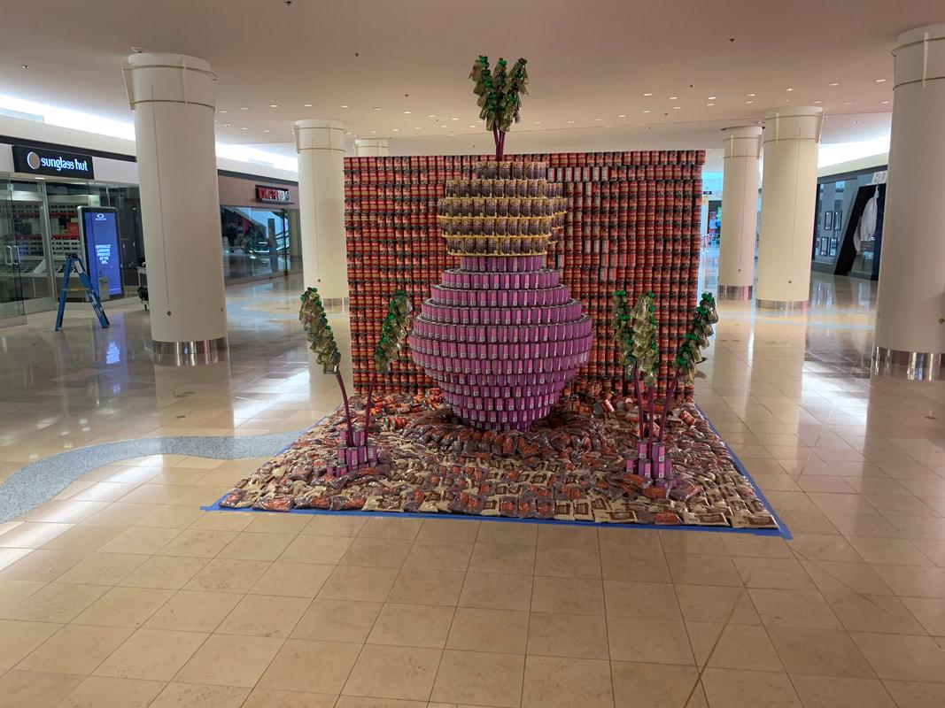
Equity con’t
Legislative Agenda: Advocating for legislation that affects our clients at federal, state, local levels
Equity and food justice: BIPOC, single mothers, caregivers, immigrants and refugees, LGBTQ individuals are disproportionately affected by hunger
Over 615,000 Oregonians receive nutrition assistance each month through the Oregon Trail Card (EBT/SNAP benefits)
Ending stigma through storytelling, such as our VOICES videos which share the stories of people experiencing hunger.
Notes:
Example - Double Up Food Bucks- provides a 1:1 match of up to $10 to Oregon Trail Card shoppers to purchase more fruits and vegetables at participating farmers markets, CSAs, and grocery stores. For example, when an Oregon Trail Card shopper spends $10 of their SNAP benefits at a participating farmers market, DUFB provides an additional $10 to buy more locally grown fruits and vegetables.
Root out Hunger CANS sculpture

Slide 30
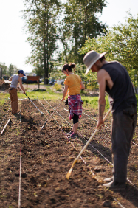
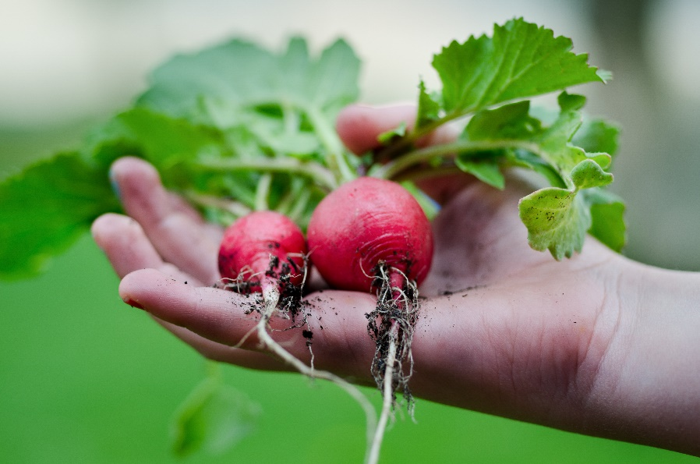
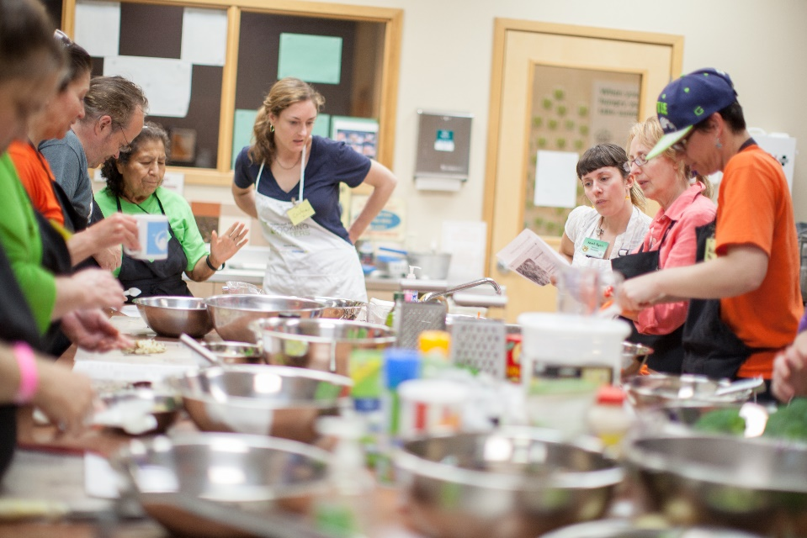
Emerging Stronger Together
Support self-sufficiency
Nutrition and garden education programs
Community food systems activities, including health screenings
Notes:
Alongside food assistance and advocacy partners across our region, Oregon Food Bank is working on creative and systemic solutions to hunger. Our collaborations and investments keep the local food system strong and address the real change needed to end hunger for good.
Mudbone Grown for example This 3-year farmer incubator program seeks to support farmers of color in the Pacific Northwest to launch their own agricultural businesses and to be a part of the creation of a farmer of color cooperative.

Slide 31
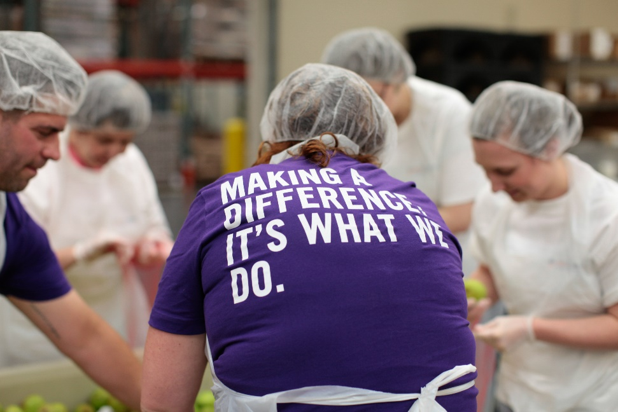
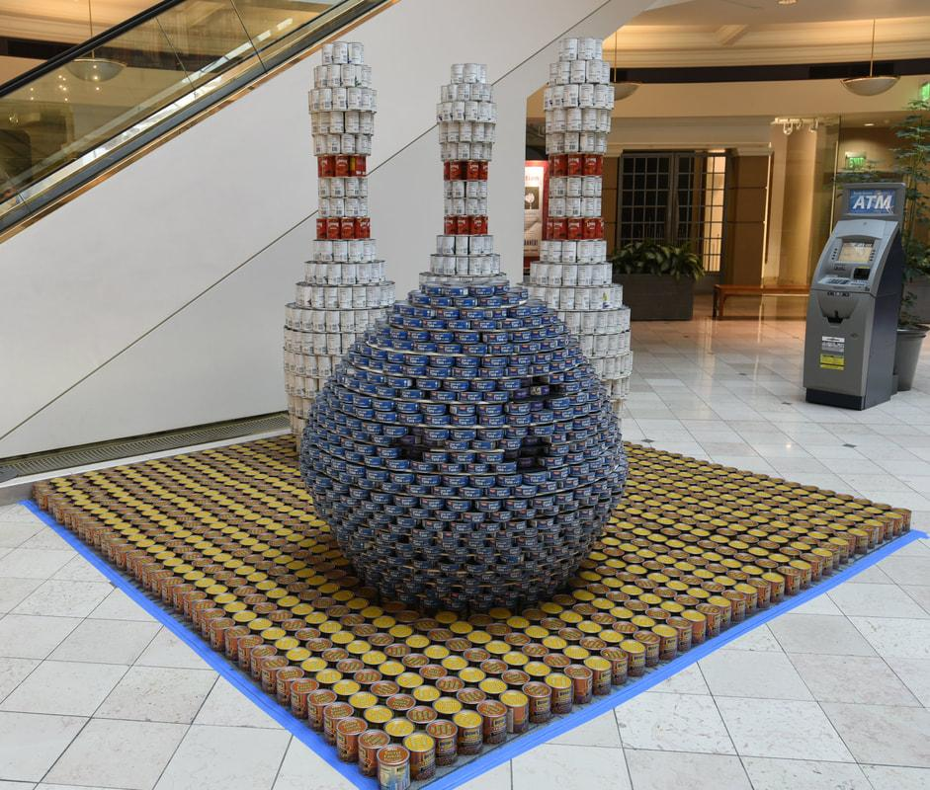
Make a difference … because no one should be hungry
You can help feed the human spirit.
Join Oregon Food Bank by donating,
volunteering, or advocating.
10 pounds = 8 meals
$10= 30 meals
Tell a message about hunger with your structure
Notes:
September is Hunger Action Month!!! CANstruction Portland is one way to take action during the month to help end hunger.
You raise money from sponsorships to having your social network give through the virtual food drive
You give your time for this project. Some even come a do team building activities like a repack at the food bank.
And you help us give a voice to hunger by building a message in your sculpture. You help us spread the facts about the state of hunger.

Slide 32
Questions?
Canstructionpdx.org | @canstructionpdx | #designbuildfeed
Notes:
We apricate you tunning into this virtual CAN-opener.

